Slide 1
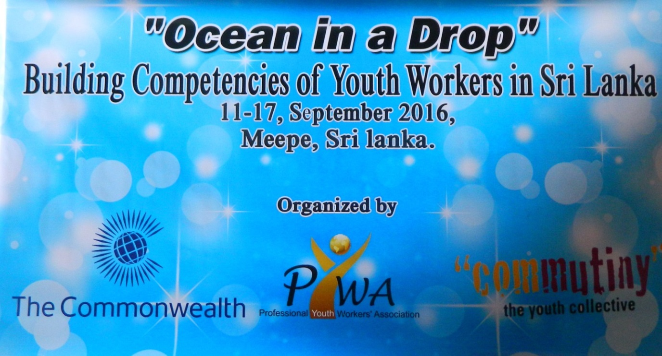

Building Competencies of Youth Workers’ in Sri Lanka – A residential training programme organized by the PYWA
At Kithul Kanda Mountain Resort
Meepe, Sri Lanka
11th – 17th September, 2016

Slide 2
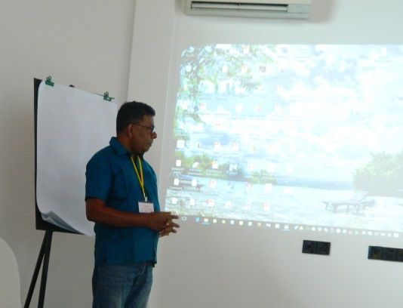
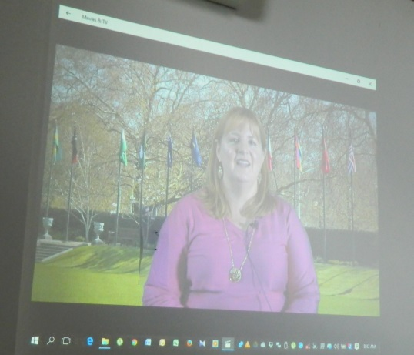
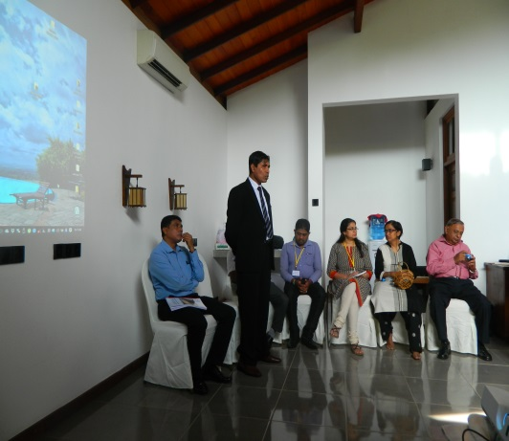
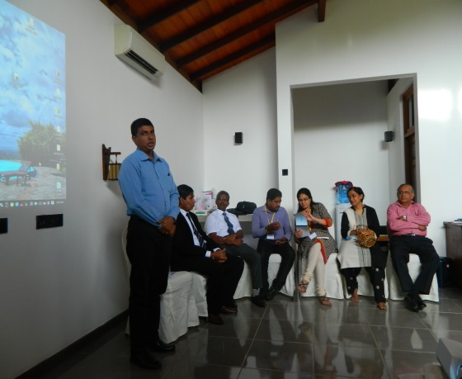
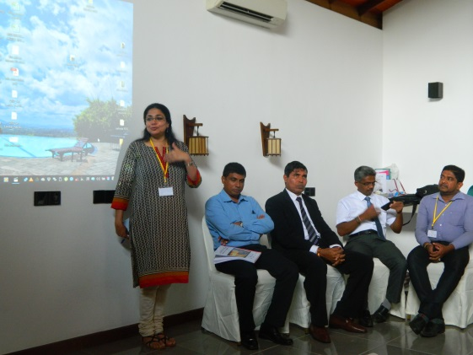
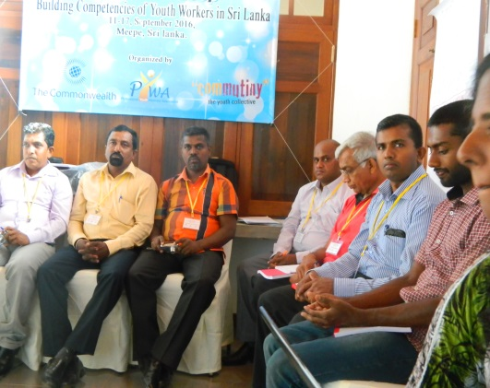
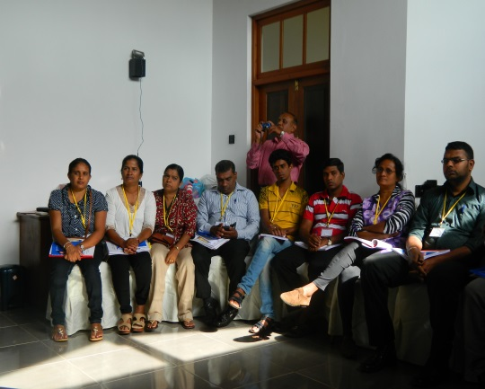
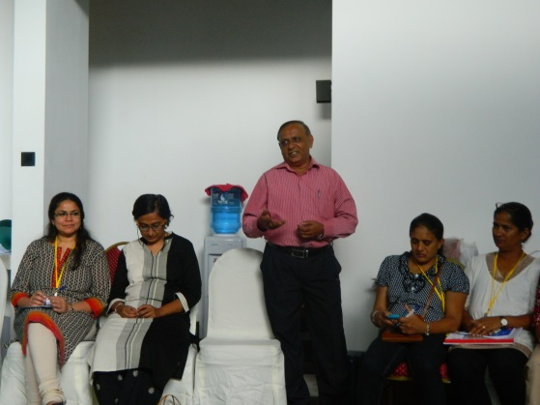
Inauguration

Slide 3
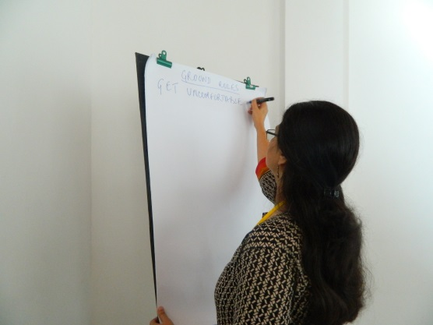
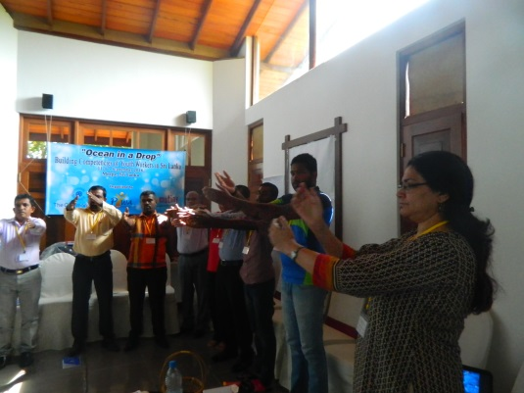
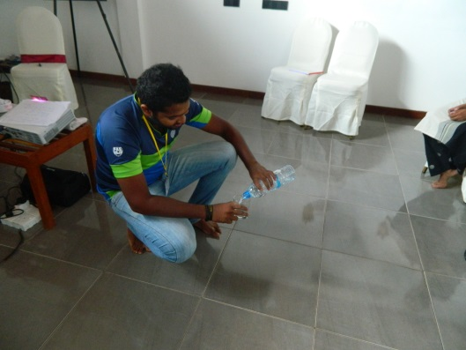
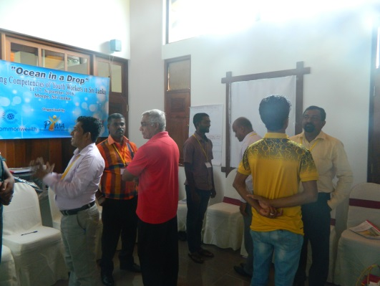
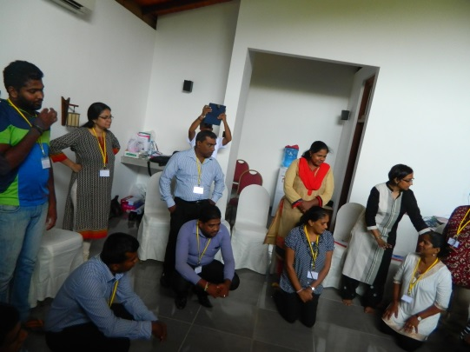
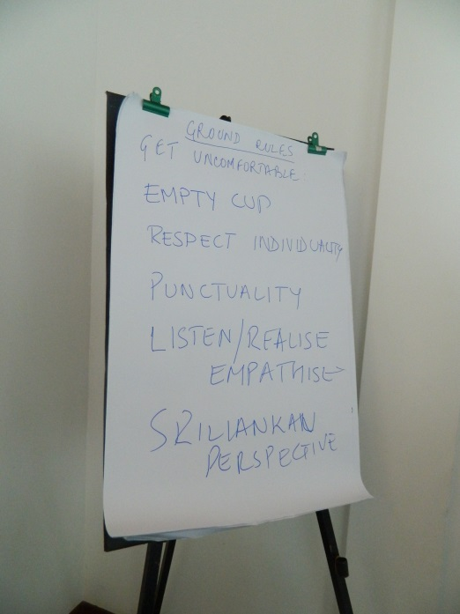
Ground Rules
Getting uncomfortable
Bottle and Cups
Respect individuality
Not to get in to personal conflicts
Punctuality
Listen, Realize and Empathize
Sri Lankan Perspective

Slide 4
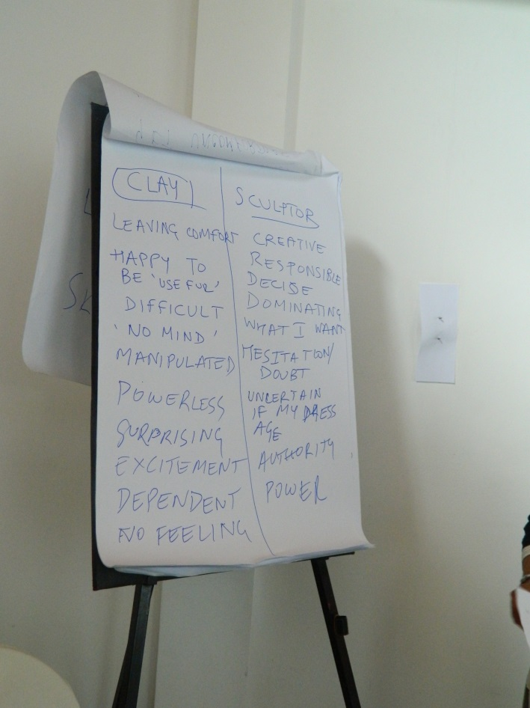
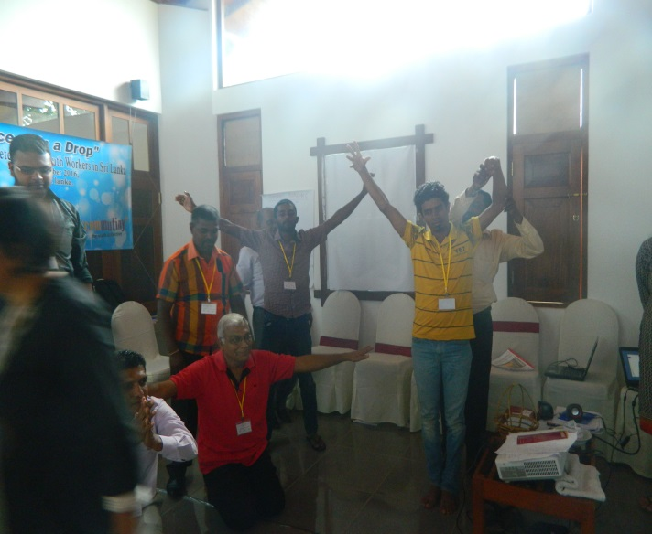
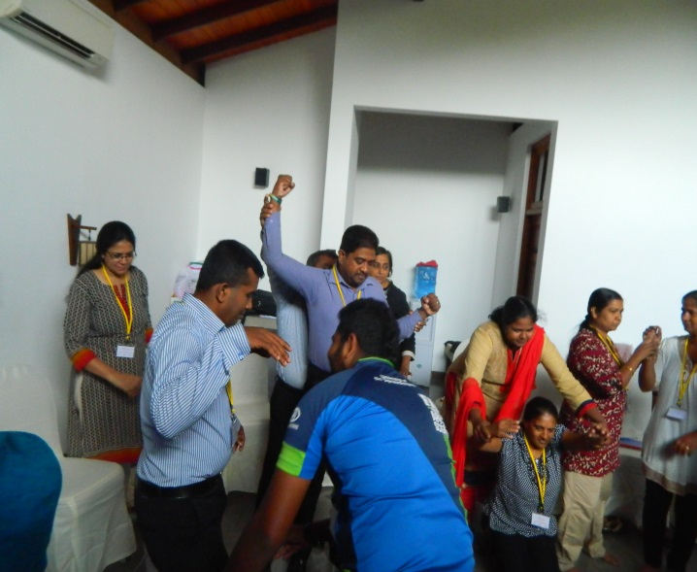
Clay and Sculptor
Unleashing the potential |Change like an eagle |trying to get up helping others |Lense |Gods |Unity |Sun life and lights | Singing songs |Special needs|Protecting groups|Energy of youth |knowledge attitudes and skills |develop competencies|Revolution |energy of youth|power|Reflection tree |singer and performer

Slide 5
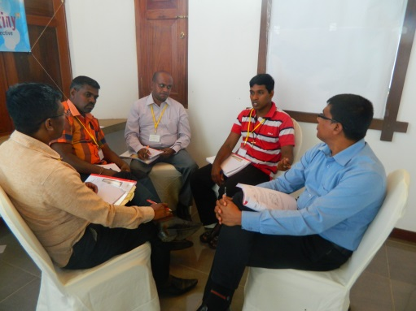
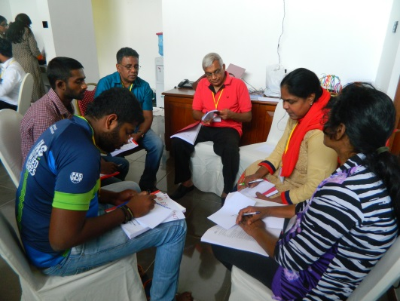
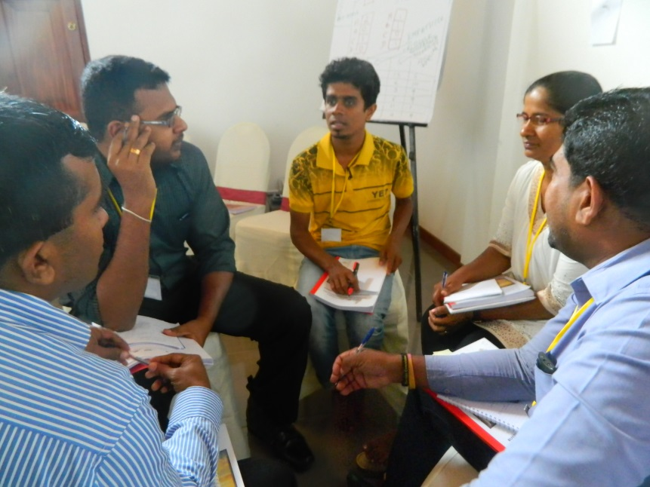
Facilitator vs. Participant
Act both roles
Be aware of the capacity
Be aware of the challenges
Be aware of the resources

Slide 6
Learning Commandments
Making the learner responsible for learning
Use two way communication involve the learner in the learning process
Introduce challenge in learning [Making the sessions challenging for the participants as facilitators]
Invoke feelings as learning is enhanced when you involve emotions
Learners need to know the big picture
Take participants from what they know to what they don’t know

Slide 7
Lenses
Economic lense:
Vocational and Skills Development
Problem solving lense:
Reproductive health and Sexuality
Youth for development/as resources, ‘instrumentalized/used’:
Environment | Politics
Youth centric development:
What are their capacities? What to do?

Slide 8
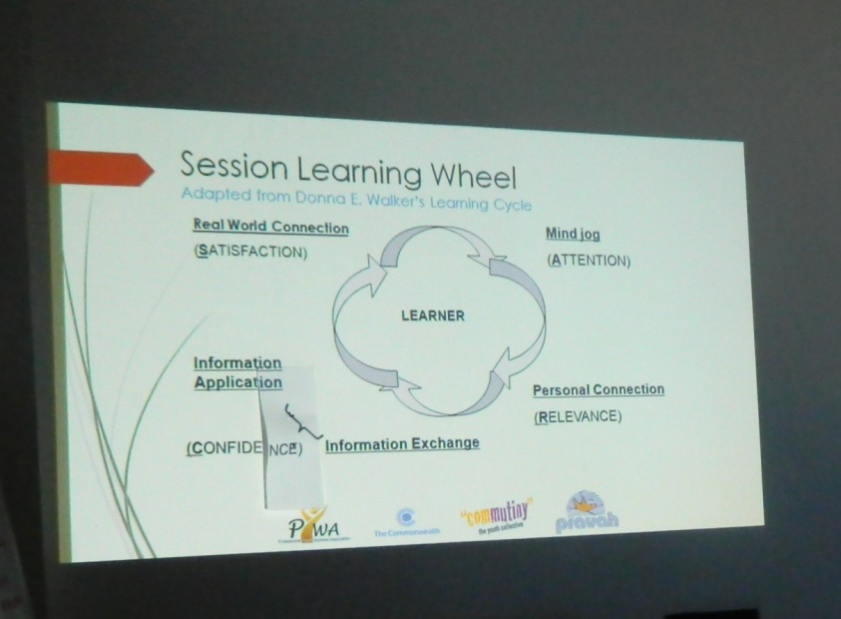
Walkers’ Cycle
Mind Jog Draw their attention
Personal Connect Relevance
Information Exchange Physical activity, talk etc.
Information Application Chance to apply what they learn | Building competencies
Real World Connection Satisfaction | changing participant behaviour to apply

Slide 9
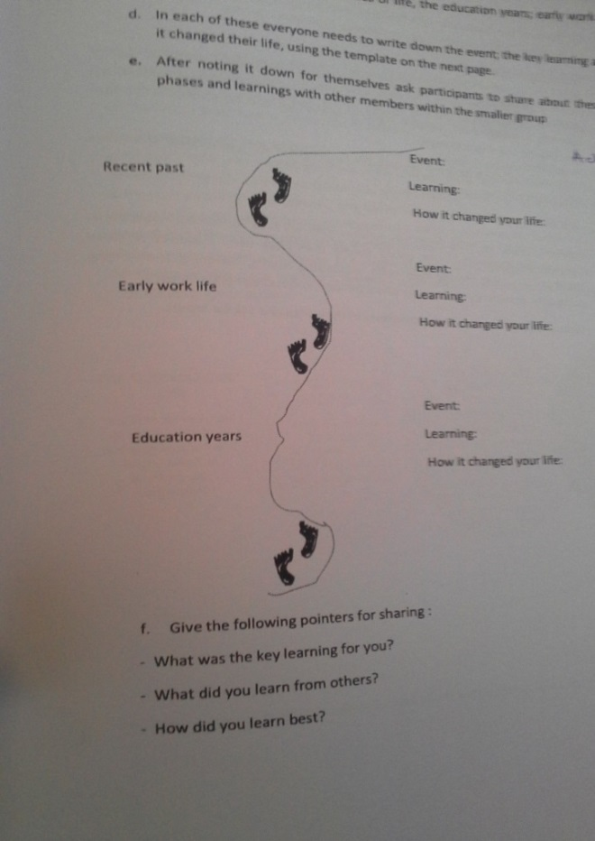
Pivotal Learning
Places
Early work life
Learning from challenges
Education through experience outside classroom

Slide 10
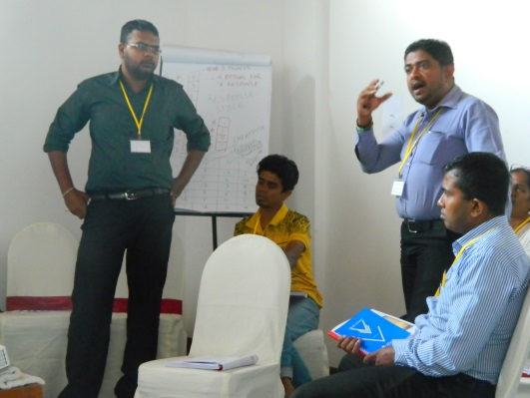
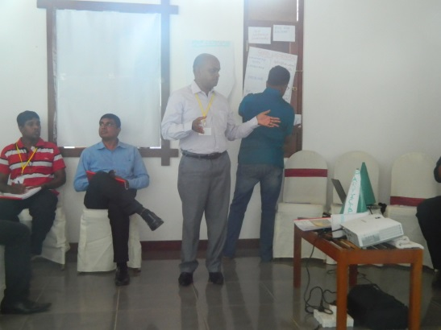
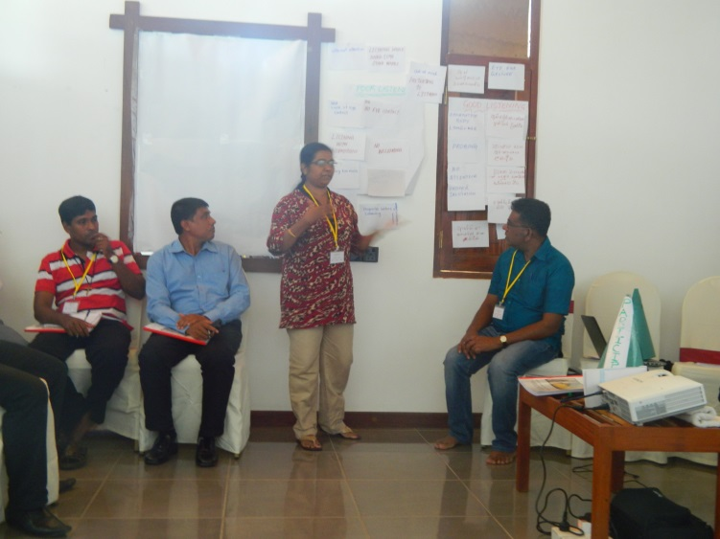
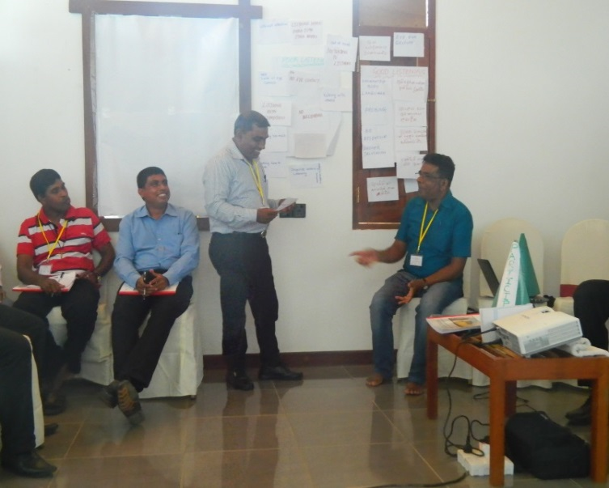
Listening
Practice ESCA
All stages in the walkers’ cycle
As a participant
As a facilitator
E | S | C | A
Empathize | Search | Confront | Advise

Slide 11
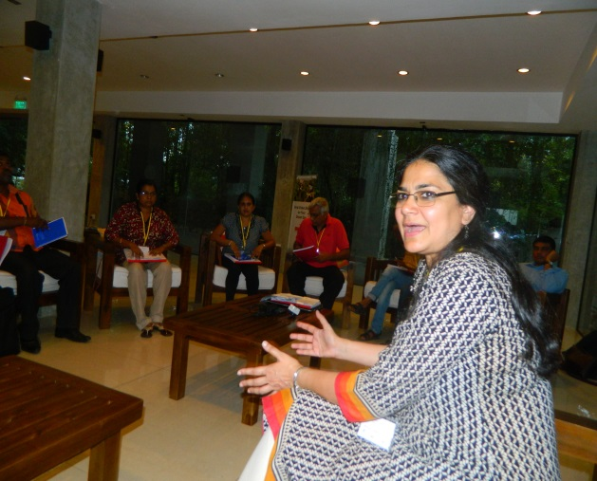
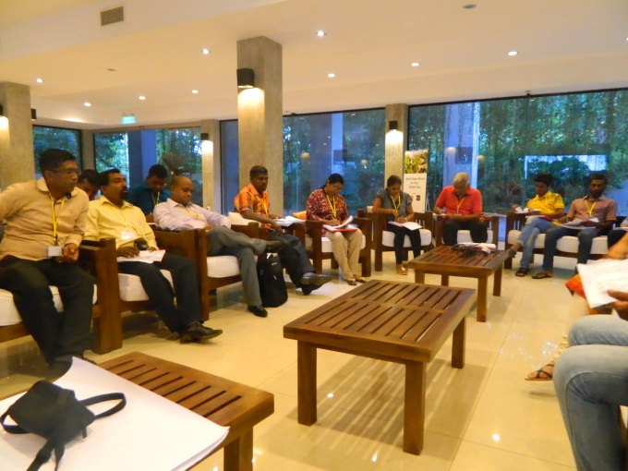
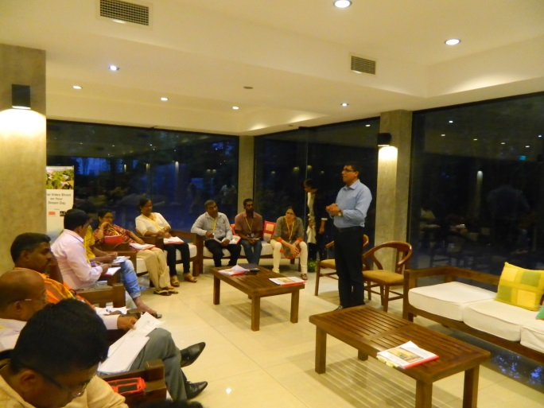
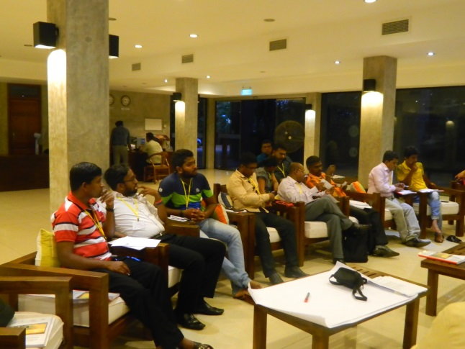
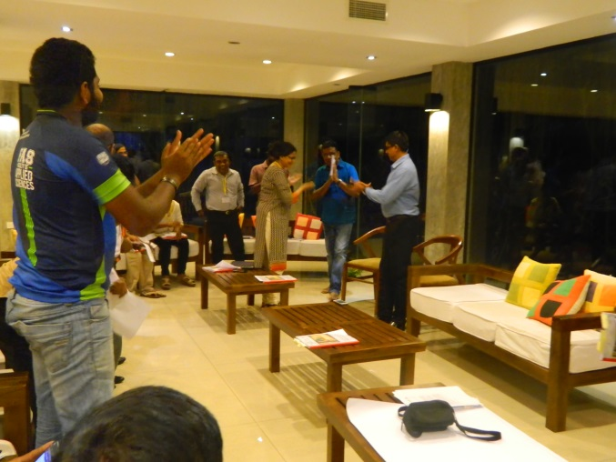
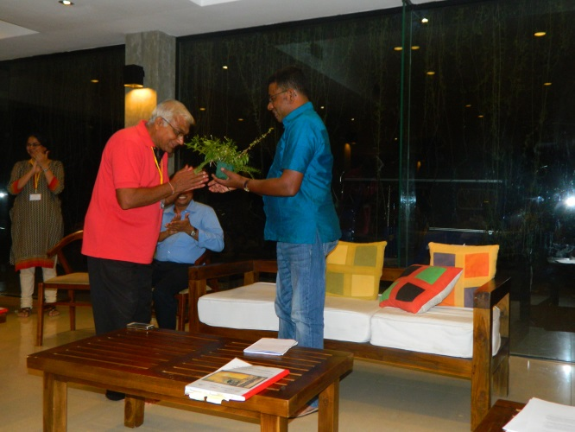
Consultation with Youth Minister

Slide 12
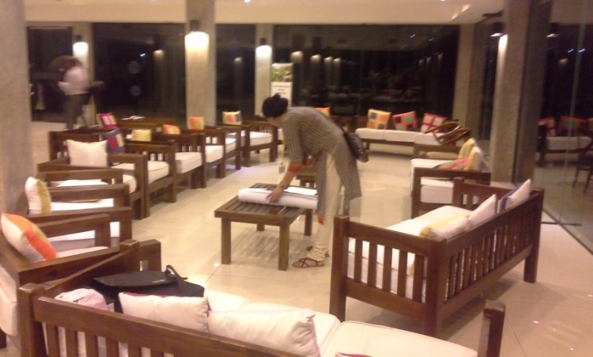
Consultation with YM
Mind Jog: If youth… |Then…
Personal Connect: Personal challenge and excitement in the youth hood
Information Exchange: Role plays with the youth minister and INGO representative
Information Application: Empower young people as facilitators and master trainers

Slide 13
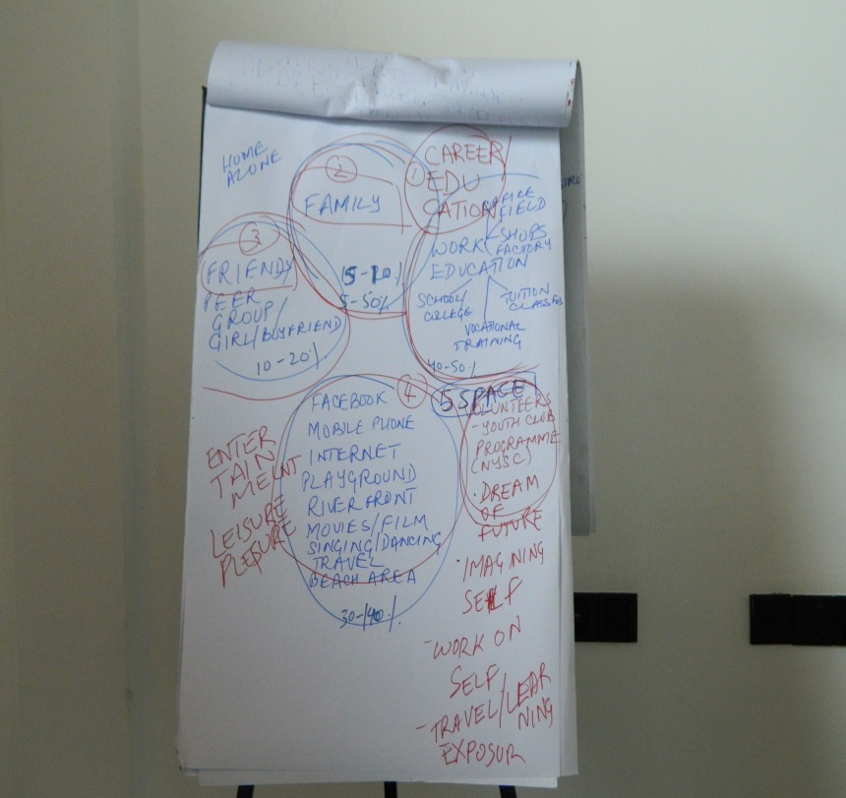
Concept of Spaces
Friends, Groups 10-20%
School, Tuition 40-50%
Social Media 30-100%
Family 5-50%
Imagined world, dreaming, exposure, volunteering, self-travel, self-learning,
5th Space

Slide 14
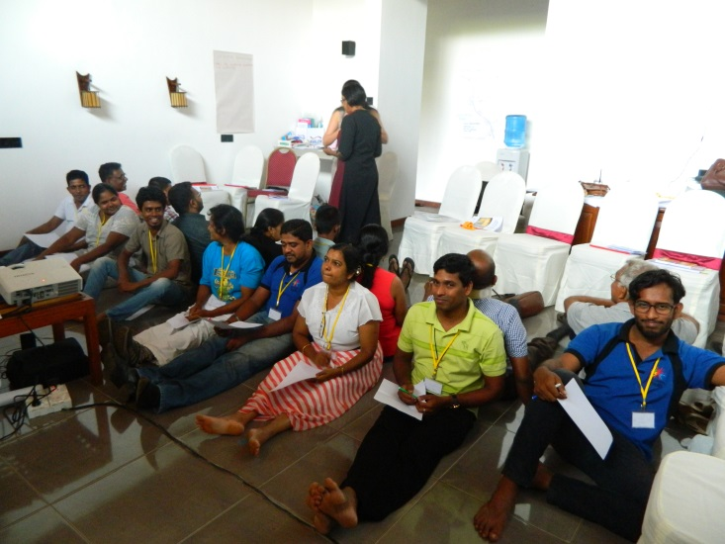
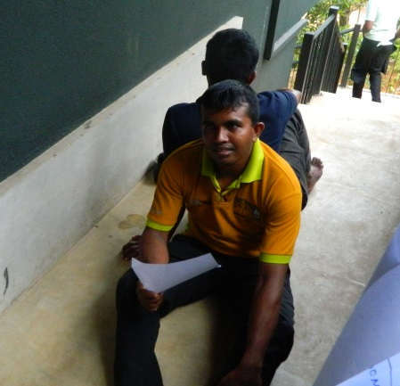
Facilitation Skills
Mind Jog: In pairs, one person giving instructions and other drawing. (Without talking talking)
Personal Connect: My facilitation style | Sharing my style | Who I am as a facilitator?
Information Exchange:
Group discussion | What are the questions you had in your group about? | What facilitation skill do the questions you had to represent?

Slide 15
IGNITE
G 1 Motivation Inspiring
G 2 Managing the people Group
G 3 Facing issues Not Controlling/ Flexible
G 4 Participation issues Involve
G 5 Planning Time
G 6 Structure Effective learning

Slide 16
Toxic River
Affalo | Ginger
10 minutes | 10 minutes
Practice session for 10 minutes
Challenge | Planning and strategies |Team work | Listen | Help others | Time management | Common sense

Slide 17
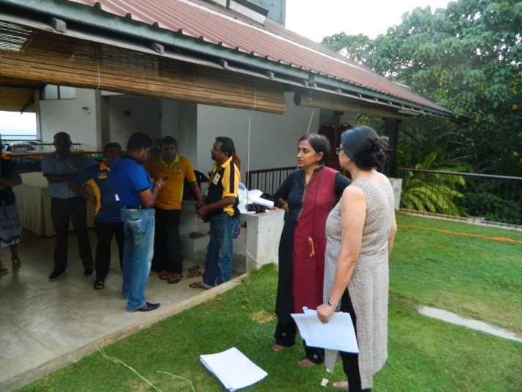
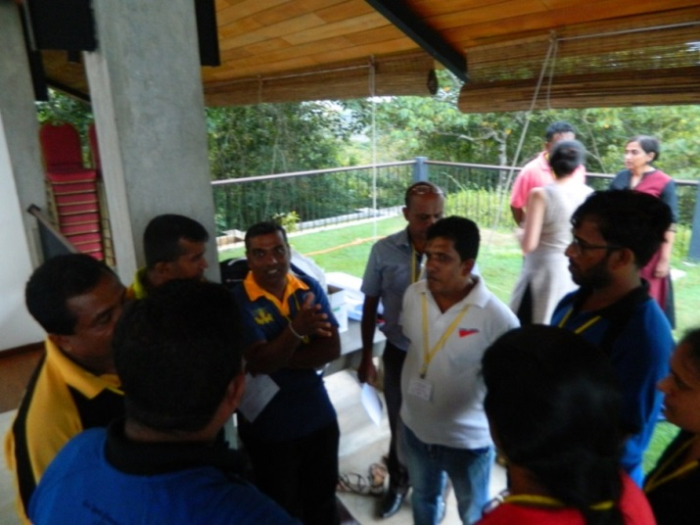
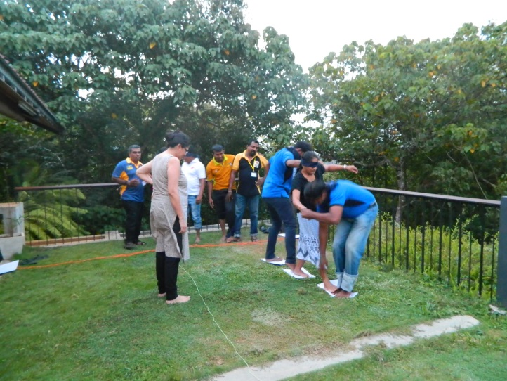
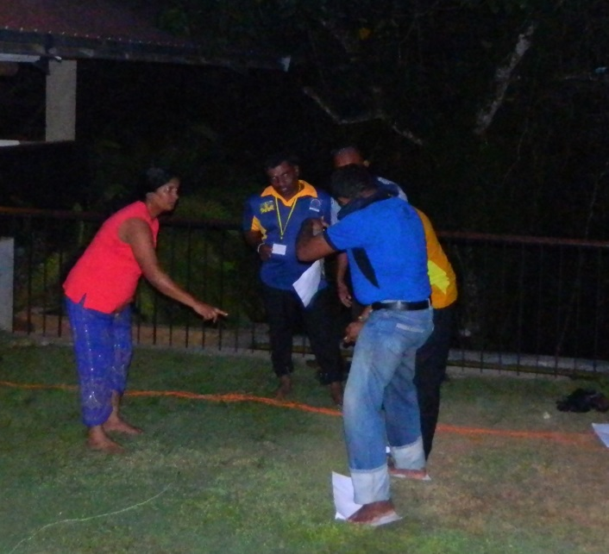
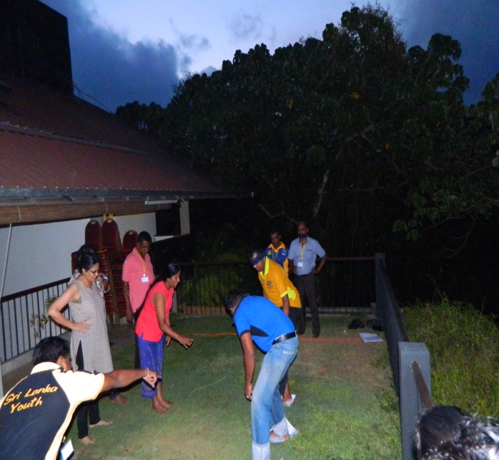
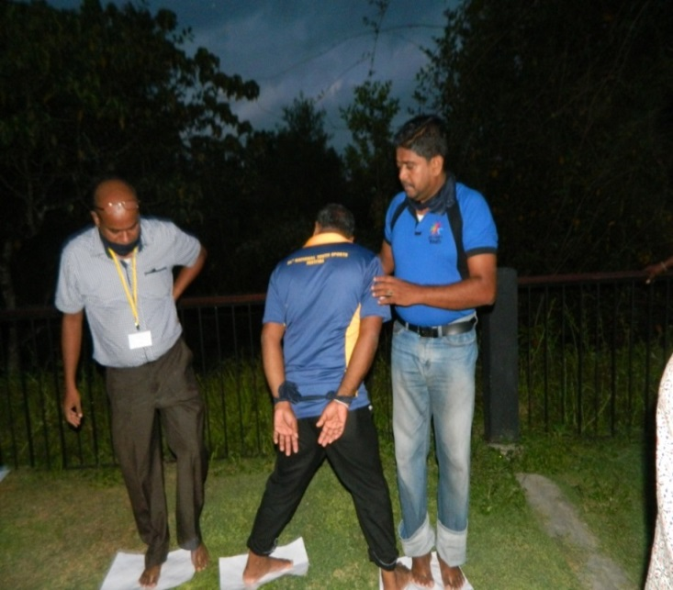
‘Affalo’ Crossing the river

Slide 18
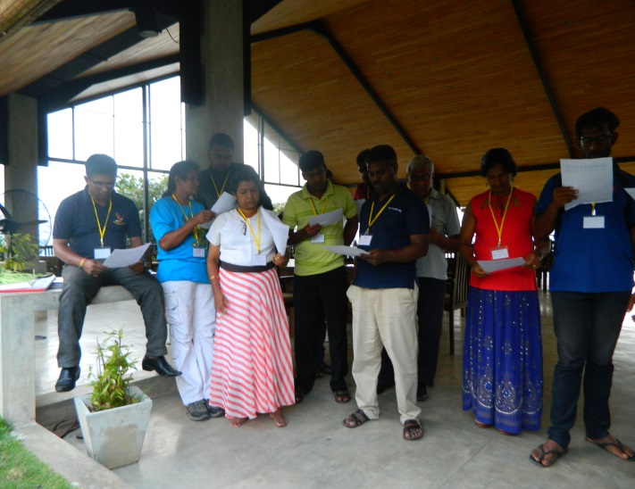
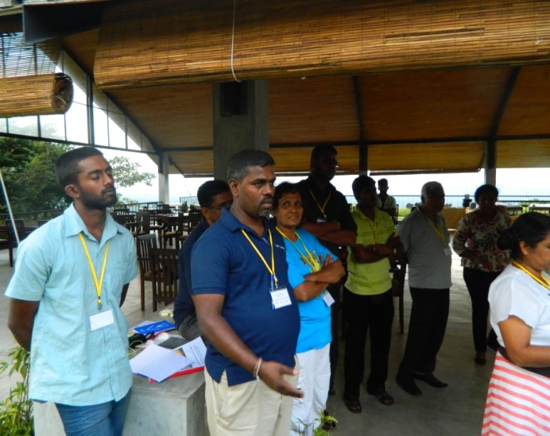
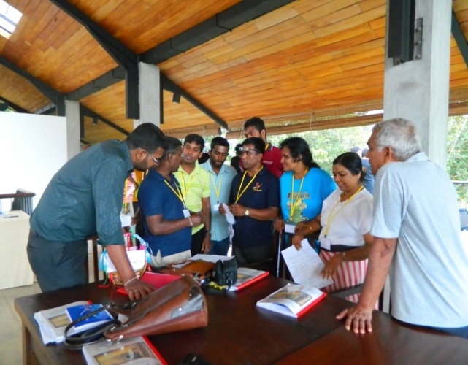
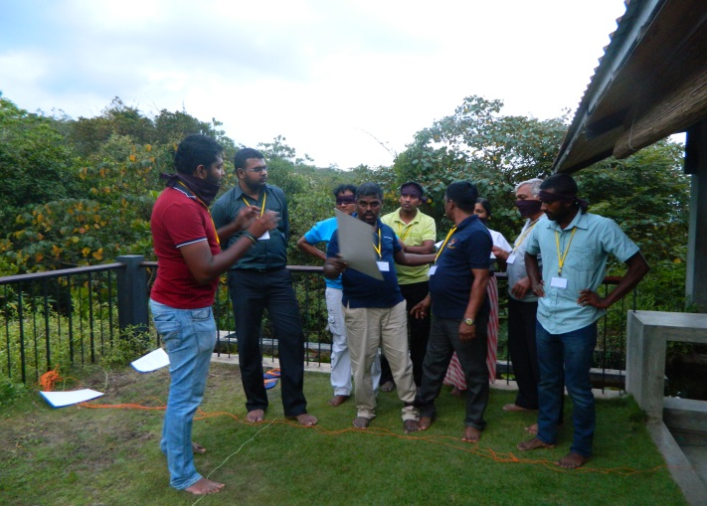
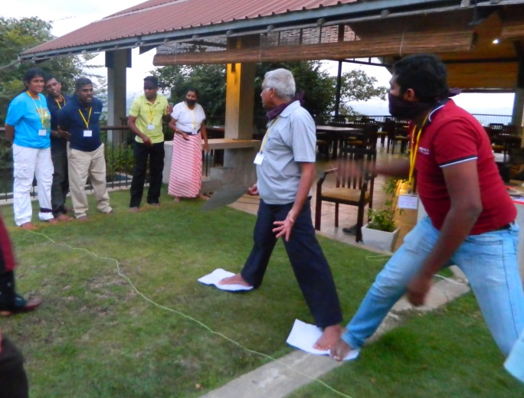
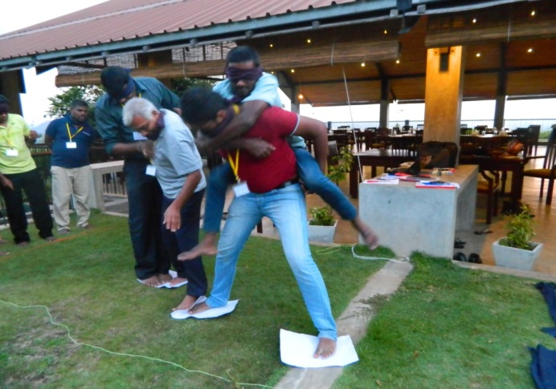
‘Ginger’ Crossing the river

Slide 19
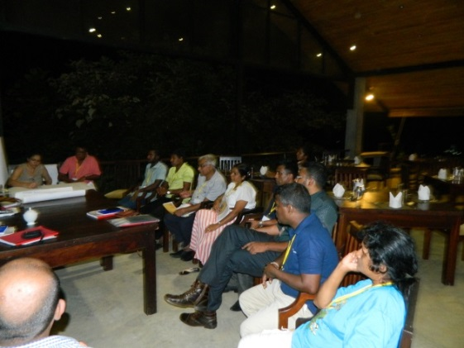



Role of a Youth Worker
Setting the agenda
Taking everyone along with you
Do everything the right way

Slide 20






Identities

Slide 21




“District quota for university entrance”

Slide 22




“Buddhism should be the state religion in SL”

Slide 23




Exclusion Tree
Seeds Root Trunk Fruits

Slide 24




Dropping the Bulb
Mythical Stories are also like that where
all of those are in our minds
Thinking of ways to create new way of thinking

Slide 25


Mythical Stories
Do you WANT change?
ASK questions
GET evidence

Slide 26












Mock Sessions

Slide 27






“What are my challenges as a youth worker?”

Slide 28



Learning Systems Thinking
Watch, Nail and Pencil
The break applied| Participants’ didn’t know the cause (nail) | Effect was visible
Laws of systems thinking: Cause and Effect are not closely related in time and space

Slide 29












Systems Thinking

Slide 30
Systems thinking ‘Youth Parliament’
Ramya Process: There should be a method to meet up at grass root levels
Ridma Structure: We should reduce the number of nominations
Nimal Process: Cabinet is selected from an interview, there can be an influence, let them select the ministers
Chathura Process and Value: Electing members should be a right of the youth in the country regardless of their organization
Shantha Process: Advisory board should have a right approach in making decisions
Wasantha Structure: Rights based approach and democratic idea, There was nothing for me when we planned the third YP, This is more like a community consultation
Neavis Energy: Board member

Slide 31

‘How wolves changed rivers’ (Video)
What did they expect when they brought in wolves?
VS
What actually happened to the river?

Slide 32


Systems Approach
Sky Vision
Water Process
Fire Shared Leadership
Earth Structure
Air Values
People With youth centric focus

Slide 33

Laws of Systems Thinking
Cause and effect are not closely related with time and space
Everything is interconnected
Faster is slower
Today’s problems come from yesterday’s solutions

Slide 34






Reflecting the Sessions

Slide 35

Way forward for ‘PYWA’
Who are we?
Where are we?
Where are we going?

Slide 36












What else did we do?

Slide 37
A Big Thank You
Ashraf: For the concept
Ridma, Chathura and Ravi: For photographs
Dinesh: For the tremendous IT support
All others how helped throughout the process

Slide 38

Building Competencies of Youth Workers’ in Sri Lanka
11th – 17th September, 2016
At Kithul Kanda Mountain Resort, Meepe

